Slide 1
GENERATION OF POLYPHASE VOLTAGES

Slide 2
REQUEST TO PLEASE NOTE DOWN MOST OF THE TOPICS

Slide 3
What is Single phase and polyphase supply
3 Phase supply

Slide 4
Single phase voltages- consist of single alternating current or voltage waveform
One armature winding
No. of armature winding increased to make it polphase
No. of independent voltage waveform= no. of winding or phases
Angle between winding
Poly- phase=== many windings

Slide 5
360/N
N=no. of windings or armature
3 phase most commonly used
Others could also be used

Slide 6
For transmitting large powers three phase are generally used
Reasons for its popularity:
(i) it is more efficient
(ii) it uses less material for a given capacity

Slide 7
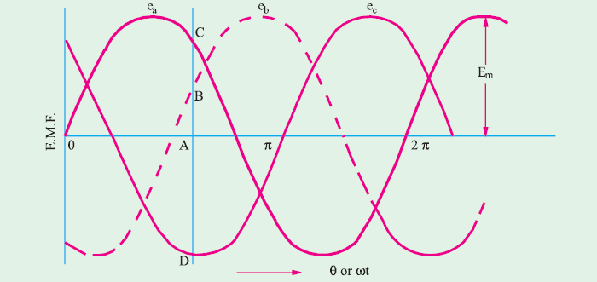

Slide 8
Ea = Em sinωt ... (i)
Eb = Em sin(ωt −120°) ... (ii)
Ec = Em sin(ωt − 240°)……(iii)
Ea+Eb+Ec=0

Slide 9
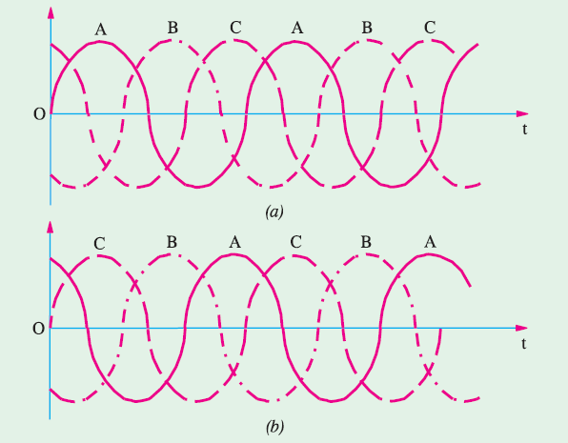
Phase Sequence
phase order or phase sequence a→b→c

Slide 10
Rotation of the Field structure reversed A-c-b
By repeating the letters, this phase sequence can be written as acbacba which is the same thing as cba. Obviously, a three-phase system has only two possible sequences : abc and cba (i.e. abc read in the reverse direction).

Slide 11
INTERCONNECTION OF THREE PHASES
Each phase or circuit would need two
conductors, the total number of conductors, in that case,being six.
Each transmission cable would contain six conductors which will make the whole system complicated and expensive

Slide 12
Interconnected
Resulting in substantial saving of copper.
The general methods of interconnection are
(a) Star or Wye (Y) connection and
(b) Mesh or Delta ( Δ ) connection.

Slide 13
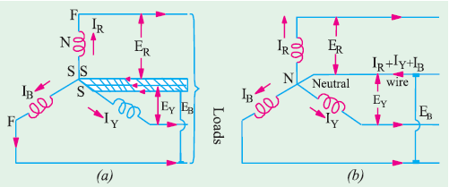
Star or Wye (Y) Connection

Slide 14
The point N is known as star point or neutral point.
point
N are replaced by a single conductor known as neutral conductor
four-wire, 3-phase system
If this three-phase voltage system is applied across a balanced symmetrical load, the neutral wire will be carrying three currents which are exactly equal in magnitude but are 120° out of phase with each
other. Hence, their vector sum is zero.
i.e. IR + IY + IB = 0
The p.d. between any terminal (or line) and neutral (or star) point gives the phase or star voltage
But the p.d. between any two lines gives the line-to-line voltage or simply line voltage.

Slide 15
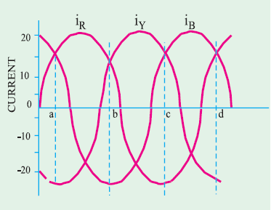

Slide 16
Voltages and Currents in Y-Connection
The voltage induced in each winding is called the phase voltage and current in each winding is likewise known as phase current.
However,the voltage available between any pair of terminals (or outers) is called line voltage (VL) and the current flowing in each line is called line current (IL ).

Slide 17
